Slide 1
Trinity University
College Web Tour
College Prep
Mr. Gordon
jgordon@bisdtx.org

Slide 2
Upcoming Events
Fri. Nov. 19th Picture Day
BISD Thanksgiving Break Nov. 22-26 You still have ACC Monday, Tuesday, and Wednesday. You will need to find your own transportation
Sat. Dec. 4th Winter Dance
Tickets are now on sale for $8
hi

Slide 3

College Web Tours
For the next several weeks, we will be researching various universities around Texas-
both public and private.
Now let’s look at Trinity University
hi

Slide 4
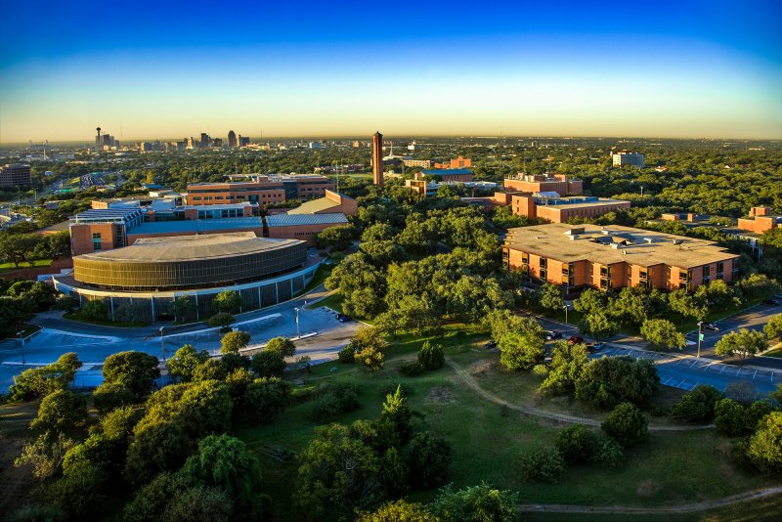
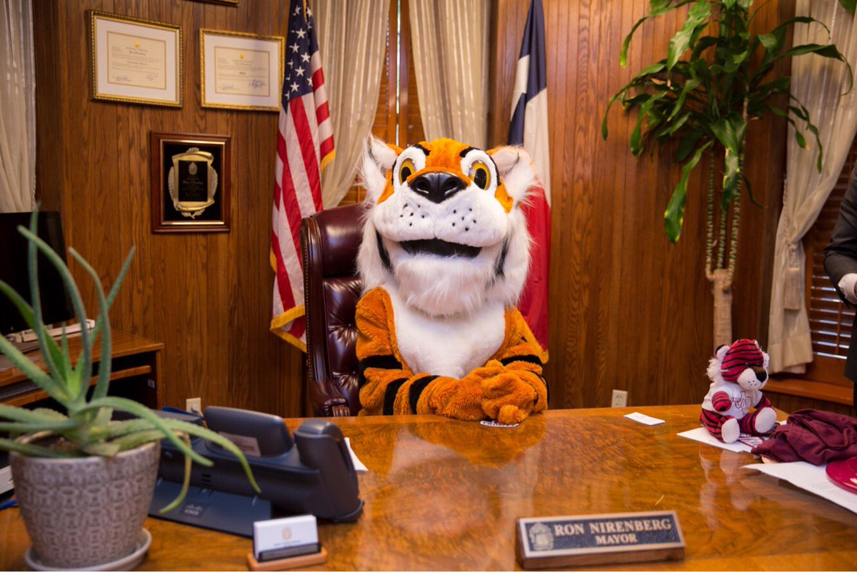
Trinity University
Quick Facts
Trinity is located in San Antonio, TX
1 ¾ hours from CRCA
Trinity is a private university.
Trinity’s mascot is LeeRoy (shrug emoji), the Tiger.
“College Consensus has named Trinity University in its 2020 list of the top 100 colleges in the nation. This year, Trinity placed No. 98 on the list and No. 4 in Texas.”
hi

Slide 5
About Texas Tech University
Go to: https://www.trinity.edu/admissions-aid/why-trinity
and find the answers to the following questions.
(You will have to also open the “Undergraduate” and “Affordability” tabs.)
1.How many freshmen applied to Trinity University? How many were allowed in?
2. What is the acceptance rate?
3. How many undergraduate students attend Trinity?
4. What is the student:faculty ratio?
5. What percentage of students graduate with no debt?
hi

Slide 6
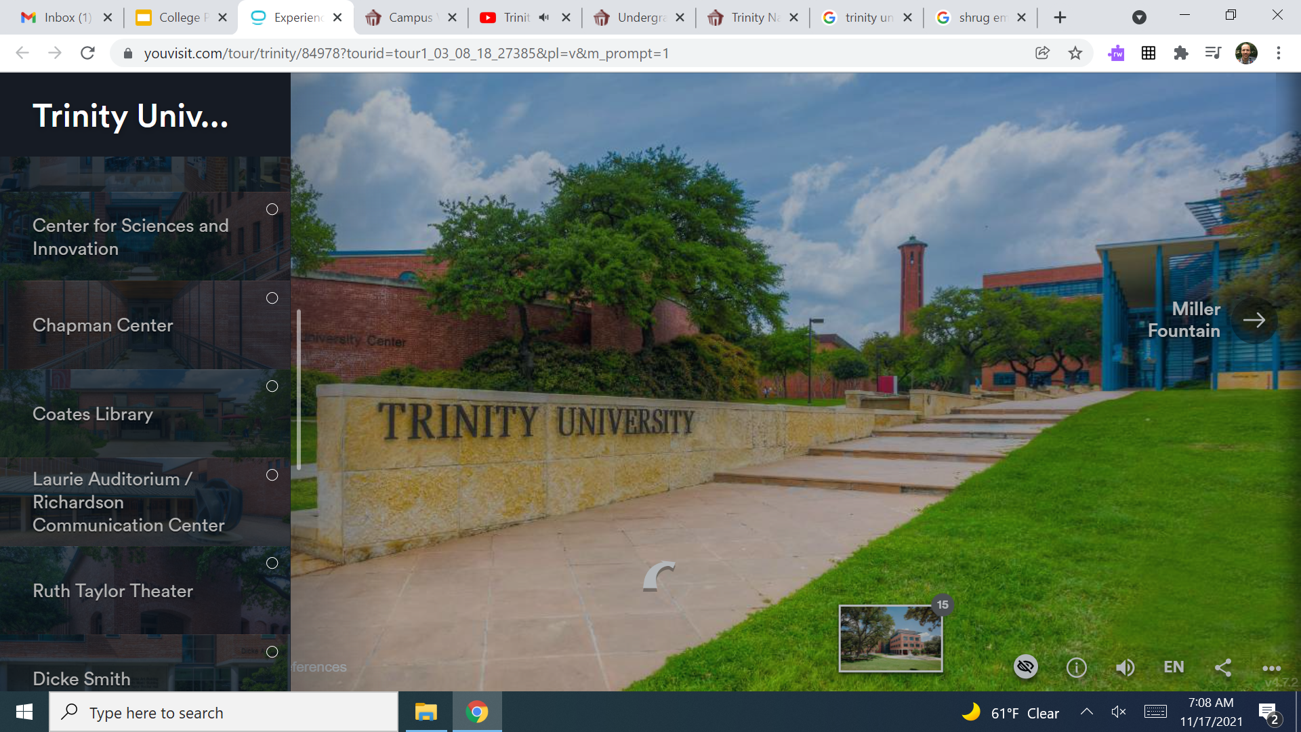
Trinity University Tour
Now take a virtual campus tour:
https://youvis.it/sngdaG
hi

Slide 7
College Prep Assignment
In the comments section of today’s College Prep,
answer the following question:
What is one thing you liked or disliked about
Trinity University?
hi

